Slide 1

Flight Delay Compensation Claim
M.Gayatri - 2520030175
S. Rishitha Reddy - 2520090039

Slide 2
Introduction
What is Flight Delay Compensation?
Flight delay compensation is a process that allows passengers to claim reimbursement when flights are significantly delayed due to airline-related issues.
Objective:
Simplify compensation claims.
Reduce manual paperwork.
Provide transparent claim tracking.
Improve customer satisfaction.

Slide 3
Problem Statement:
Existing Problems:
Lengthy claim process.
Manual verification.
Lack of claim status visibility.
Delayed compensation payments.
Proposed Solution
Develop a digital system that:
Automates claim submission.
Verifies eligibility.
Tracks claim status.
Processes compensation efficiently.

Slide 4
System Features
Key Features:
User Registration/Login
Flight Information Submission
Delay Verification
Compensation Eligibility Check
Claim Tracking Dashboard
Notification System
Admin Approval Panel

Slide 5
Modules Of The System
Module Description
📄 Claim Form Submit flight delay claims
✅ Eligibility Checker Check compensation eligibility
📁 Document Upload Upload required documents
✔ Input Validation Verify user information
📜 Claim History View previous claims
💬 Support Chat Get customer assistance
📊 Status Tracking Track claim progress
👨‍💼 Admin Review Review and approve claims
📧 Email Notification Send claim updates
❓ FAQ & Help Provide user guidance
📑 PDF Export Download claim reports
📱 Responsive UI Support all devices

Slide 6
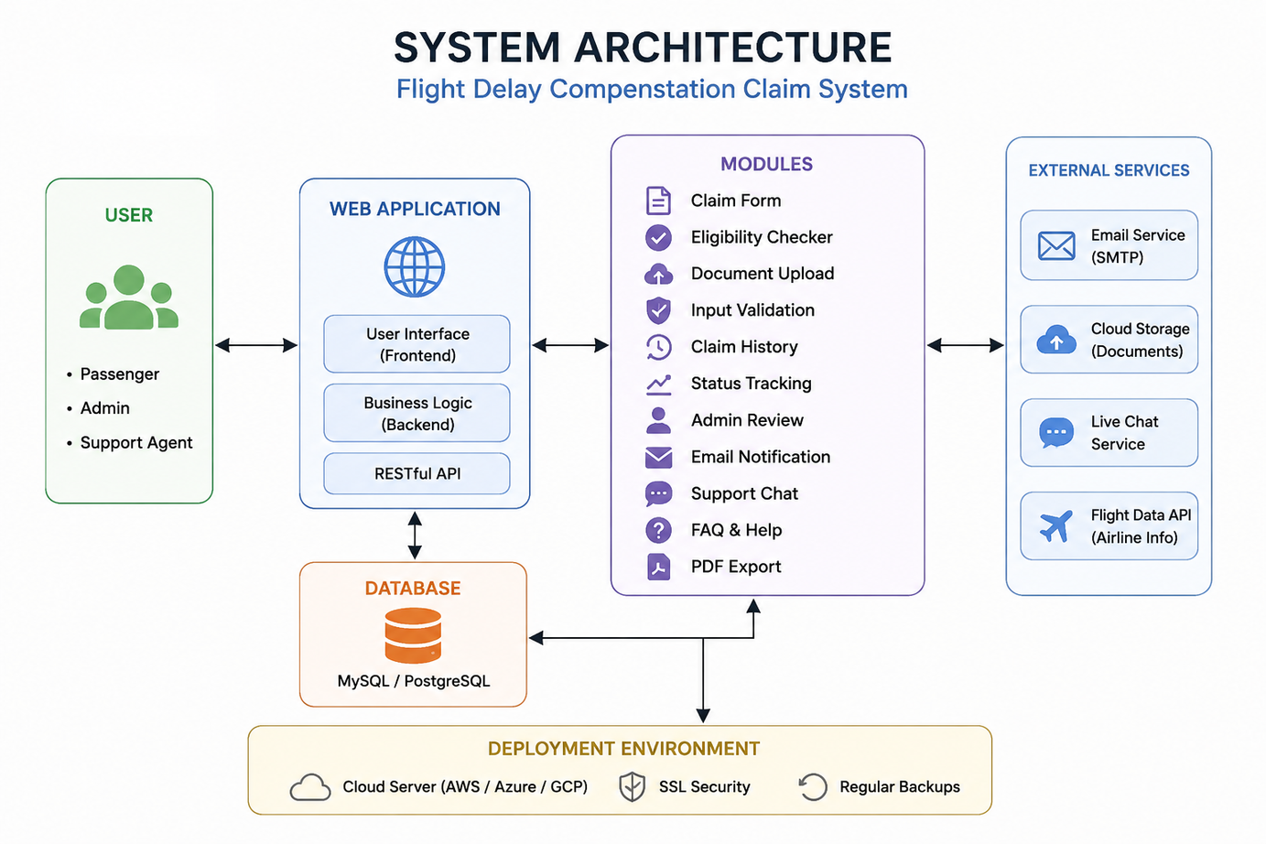
System Architecture

Slide 7
Technologies Used
Frontend
HTML
CSS
JavaScript
Backend
Flask / Node.js
Database
MySQL / MongoDB
Tools
VS Code
GitHub

Slide 8
Workflow
Claim Process:
Passenger enters flight details.
System checks delay duration.
Eligibility is verified.
Claim is submitted.
Admin reviews request.
Compensation is approved/rejected.
User receives notification.

Slide 9
Future Enhancements
Future Scope:
AI-based fraud detection
Mobile application
Real-time flight tracking
Multi-airline integration
Online payment gateway

Slide 10
Conclusion
The Flight Delay Compensation Claim System streamlines the compensation process by automating claim submission, verification, and tracking, resulting in faster resolutions and improved passenger satisfaction.

Slide 11
Thank You

